Slide 1
Troy davis and the eighth amendment
Gautam Narula
Author, Remain Free
Lincoln-Sudbury High School
May 22, 2017

Slide 2
Amendment VIII to the US Constitution
Excessive bail shall not be required, nor excessive fines imposed, nor cruel and unusual punishments inflicted.

Slide 3
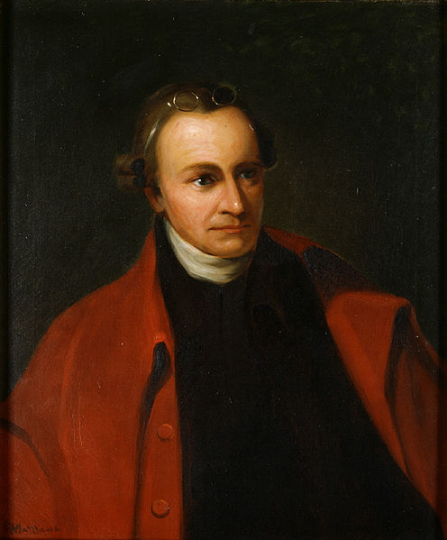
History of the Eighth Amendment
“That excessive bail ought not to be required, nor excessive fines imposed, nor cruel and unusual punishments inflicted;” - English Bill of Rights (1689)
“That excessive bail ought not to be required, nor excessive fines imposed, nor cruel and unusual punishments inflicted.” – Virginia Declaration of Rights, Section IX (1776)
“What says our [Virginia] bill of rights?—‘that excessive bail ought not to be required, nor excessive fines imposed, nor cruel and unusual punishments inflicted.’. . . Will [Congress] find sentiments there similar to this bill of rights?. . . But Congress. . . may introduce the practice of France, Spain, and Germany--of torturing, to extort a confession of the crime.” – Patrick Henry, Debate in Virginia Ratifying Convention (1788)

Slide 4
The Eighth Amendment and Capital Punishment
Equal protection and Due Process clauses of the 14th Amendment allows the Eighth Amendment to be applied to state laws
Wilkerson v Utah (1879): Execution by firing squad doesn’t violate the Eighth Amendment
Furman v Georgia (1972): Inconsistent/arbitrary death penalty application violates the Eighth Amendment; moratorium on death penalty in the United States
Gregg v Georgia (1976): The death penalty itself doesn’t violate the Eighth Amendment as long as certain procedures are followed; ended moratorium
Coker v Georgia (1977): Execution for rape (of an adult) violates the eighth amendment
Edmund v Florida (1982): Executing someone who didn’t intend to kill violates the eighth amendment
Ford v. Wainright (1986): Executing the insane violates the eight amendment
Thompson v. Oklahoma (1988): Executions for crimes committed before the age of 16 is cruel and unusual
Stanford v Kentucky (1989): Eighth amendment permits executing people for crime committed at ages 16 and 17.
Penry v Lynaugh (1989): Permissible to execute the mentally retarded
Atkins v Virginia (2002): Overturned Penry, unconstitutional to execute the mentally retarded
Roper v Simmons (2005): Overturned Stanford, unconstitutional to execute for crime committed by minors
Kennedy v Louisiana (2008): Execution for rape (of a child) violates the eighth amendment; cannot execute for crimes that didn’t result in death unless they were crimes against the state (espionage, treason, etc)
Baze v Rees (2008): Upheld constitutionality of Kentucky’s lethal injection regime

Slide 5
Death Penalty Trends

Slide 6
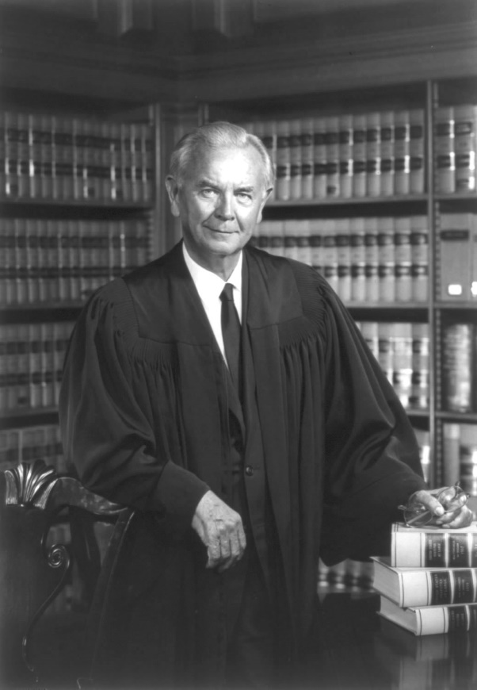
What is Cruel and Unusual?
Justice Brennan, Furman v Georgia (1972)
“A punishment must not by its severity be degrading to human dignity,“
"A severe punishment that is obviously inflicted in wholly arbitrary fashion.“
"A severe punishment that is clearly and totally rejected throughout society.“
"A severe punishment that is patently unnecessary."

Slide 7
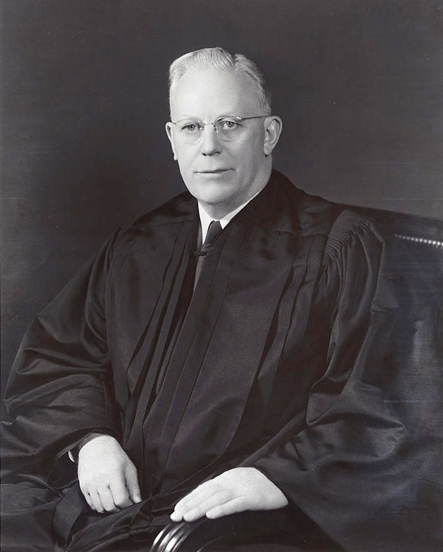
Who Determines Cruel and Unusual?
Chief Justice Warren, Trop v. Dulles (1958)
“The [Eighth] Amendment must draw its meaning from the evolving standards of decency that mark the progress of a maturing society."
Abolition strategy based on Evolving Standards

Slide 8
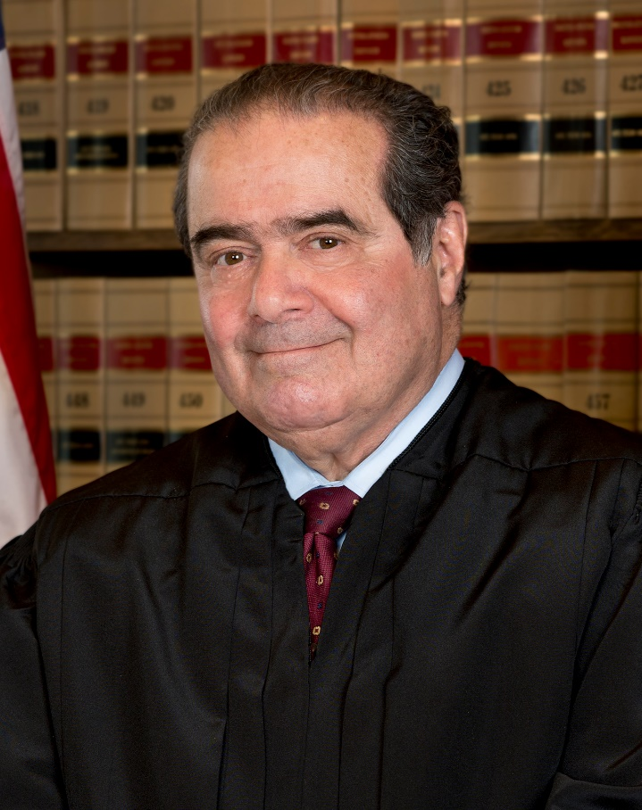
Originalists vs. Evolving Standards
Justice Scalia, Thompson v. Oklahoma (1988)
“[T]he risk of assessing evolving standards is that it is all too easy to believe that evolution has culminated in one’s own views.”
“The Eighth Amendment…means…‘what we consider cruel today’; otherwise we have no protection against the moral perceptions of a future, more brutal generation. It is…rooted in the moral perceptions of the time. On this analysis…capital punishment, which was widely in use in 1791, does not violate the abstract principle of the Eighth Amendment.” A Matter of Interpretation: Federal Courts and the Law (1998)
Justice Clarence Thomas (stay tuned…)

Slide 9
Davis v. Georgia
Davis v. Georgia, Petition for Writ of Certiorari (2008)
“Mr. Davis’ request for an evidentiary hearing… sharply split the Supreme Court of Georgia. [S]even of nine State witnesses have recanted their trial testimony, and several new witnesses have identified or implicated a different individual, Redd Coles, as the shooter…Does the Eighth Amendment to the U.S. Constitution create a substantive right of the innocent not to be executed…when substantial evidence of innocence is discovered?”
“Mr. Davis’ case allows this Court an opportunity to determine what it has only before assumed: that the execution of an innocent man is constitutionally abhorrent. The Court need only determine if the Eighth Amendment bars execution of the innocent and then decide…whether Georgia’s…procedures afford sufficient due process protection.”

Slide 10
My Involvement
Gautam Narula, Letter to Troy Davis (2008)
“…[w]hat I found most chilling was Monday’s Georgia Supreme Court decision to deny you a stay of execution, on the grounds that it wasn’t ‘in their jurisdiction’. What if the Supreme Court hadn’t called an emergency session on Tuesday?
...[W]hy was the State in such a rush to execute you, instead of waiting six more days for the Supreme Court decision?”

Slide 11
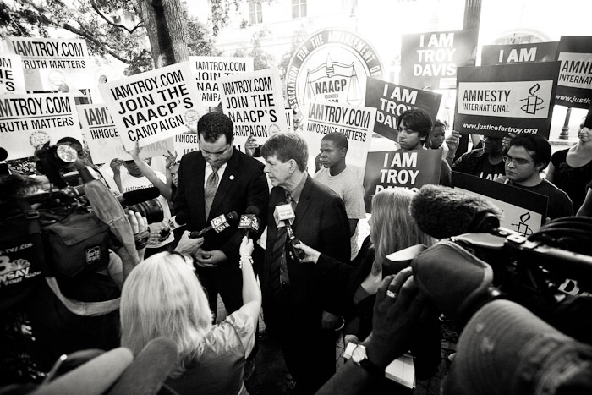
Savannah Hearing
Gautam Narula, Clearly Established Innocence: An Account of the Troy Davis Hearing (2010)
“Is it constitutional to execute a person who has proven their innocence, as long as that person had received a fair trial? While this question obviously sounds absurd, it was in fact a legitimate legal question in the hearing, and Judge Moore noted that the Supreme Court has repeatedly deflected such questions over the past two decades…”

Slide 12
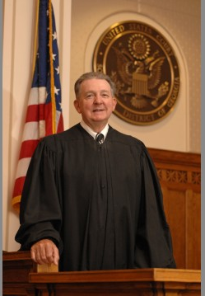
Savannah Hearing (2)
Judge Moore, In re Troy Anthony Davis (2010)
“[W]hile Mr. Davis's new evidence casts some additional, minimal doubt on his conviction, it is largely smoke and mirrors.
“[T]his court concludes that executing an
innocent person would violate the Eighth Amendment of the United States Constitution. However, Mr. Davis is not innocent…
“the Court is left with the firm conviction
that while the State's case may not be ironclad, most reasonable jurors would again vote to convict Mr. Davis…”

Slide 13
September 21, 2011
Supreme Court denies stay of execution

Slide 15
Impact
Letter to Troy Davis, September 15, 2011
I wanted to write to you in case the unthinkable happens, and this is our last communication.
I first want to thank you for all that you've done for me. When I was fifteen years old, I was a very different person. I supported the death penalty and brushed aside the possibility of an innocent person being executed. I had no more than a mild interest in human rights or social justice…I believed I had the moral authority to say who was beyond redemption and deserved to die. I obviously don't think like that anymore, and it's because I met you….
I also wanted to make a promise to you. My promise is that, regardless of what may happen in the coming few weeks, I won't forget that there are other Troy Davises out there. I promise that I won't sit back when I see an injustice occur. I promise that I won't stop working to end the death penalty once and for all in the United States. I promise that, for the rest of my life, I Am Troy Davis.

Slide 16
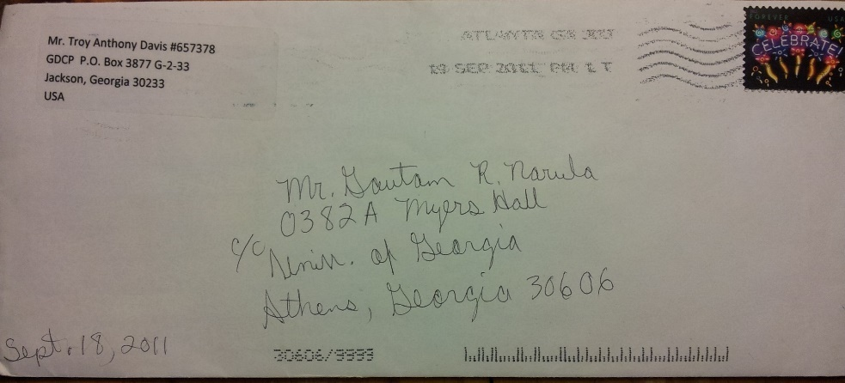
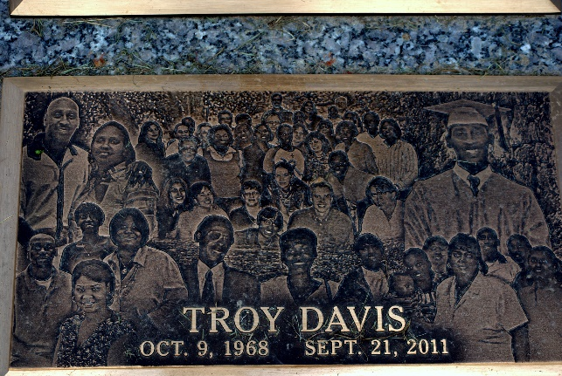
Impact (2)
Letter to Gautam Narula, September 18, 2011
How's my nephew holding up these days? I heard you and Pranavi were at the rally Friday evening. I'm glad to know you were able to make it. Give everyone my love for me.
You already know I'm proud of you but stay focused on the direction you want your life to go. Every decision today directs your tomorrow. I want you to enjoy your youth but don't forget to consistently tell those you love what they mean to you.
Well my back meds are kicking in and…disrupting my thoughts somewhat so take care and remain prayerful. Remember that in life we don't always get what we want but even when faced with the worst of times, God will open a window of hope and a door to prosperity.

Slide 17
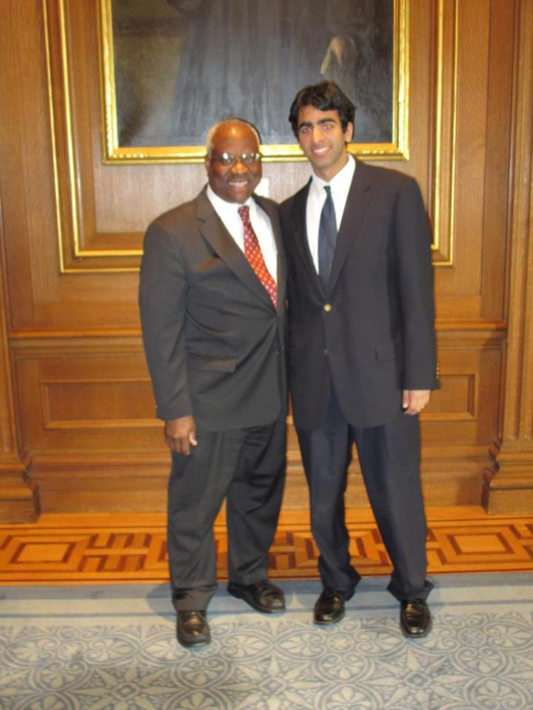
Clarence Thomas
Meeting with Justice Thomas, 2012
Wasn’t the binary choice between execution and freedom, with no middle ground (life in prison) for establishing doubt, a failure of our justice system?
Isn’t “Cruel and Unusual” is inherently subjective? Won’t Troy Davis’s execution someday be seen as a violation of the Eighth Amendment?

Slide 18
Questions
Why did the Supreme Court deflect questions about the execution of innocents?
Is “Cruel and Unusual” an evolving standard? How should we measure what our current standards are? Or are Justices Thomas and Scalia right when they say it should be interpreted based on American standards in 1791?
Is it Cruel and Unusual to execute those who’ve demonstrated at least a “minimal” level of doubt, even if they can’t prove innocence?
Should capital punishment be addressed at the state level (Clarence Thomas), or at the federal level?
Is capital punishment Cruel and Unusual punishment?

Slide 19
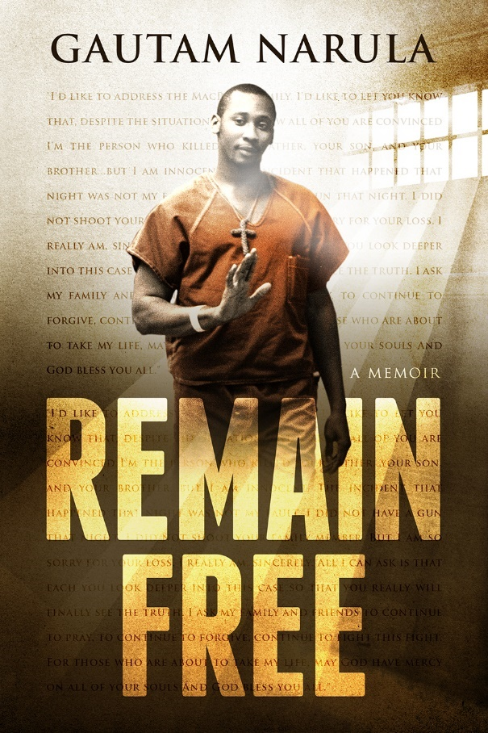
For More Information
Resources
www.remainfree.com/ls (tinyurl.com/lincolnsudbury)
gautamnarula@gmail.com
www.remainfree.com/read-online
Remain Free available on Amazon, LS library

